Slide 1
Portfolio website
Created by Tiffany Fai

Slide 2

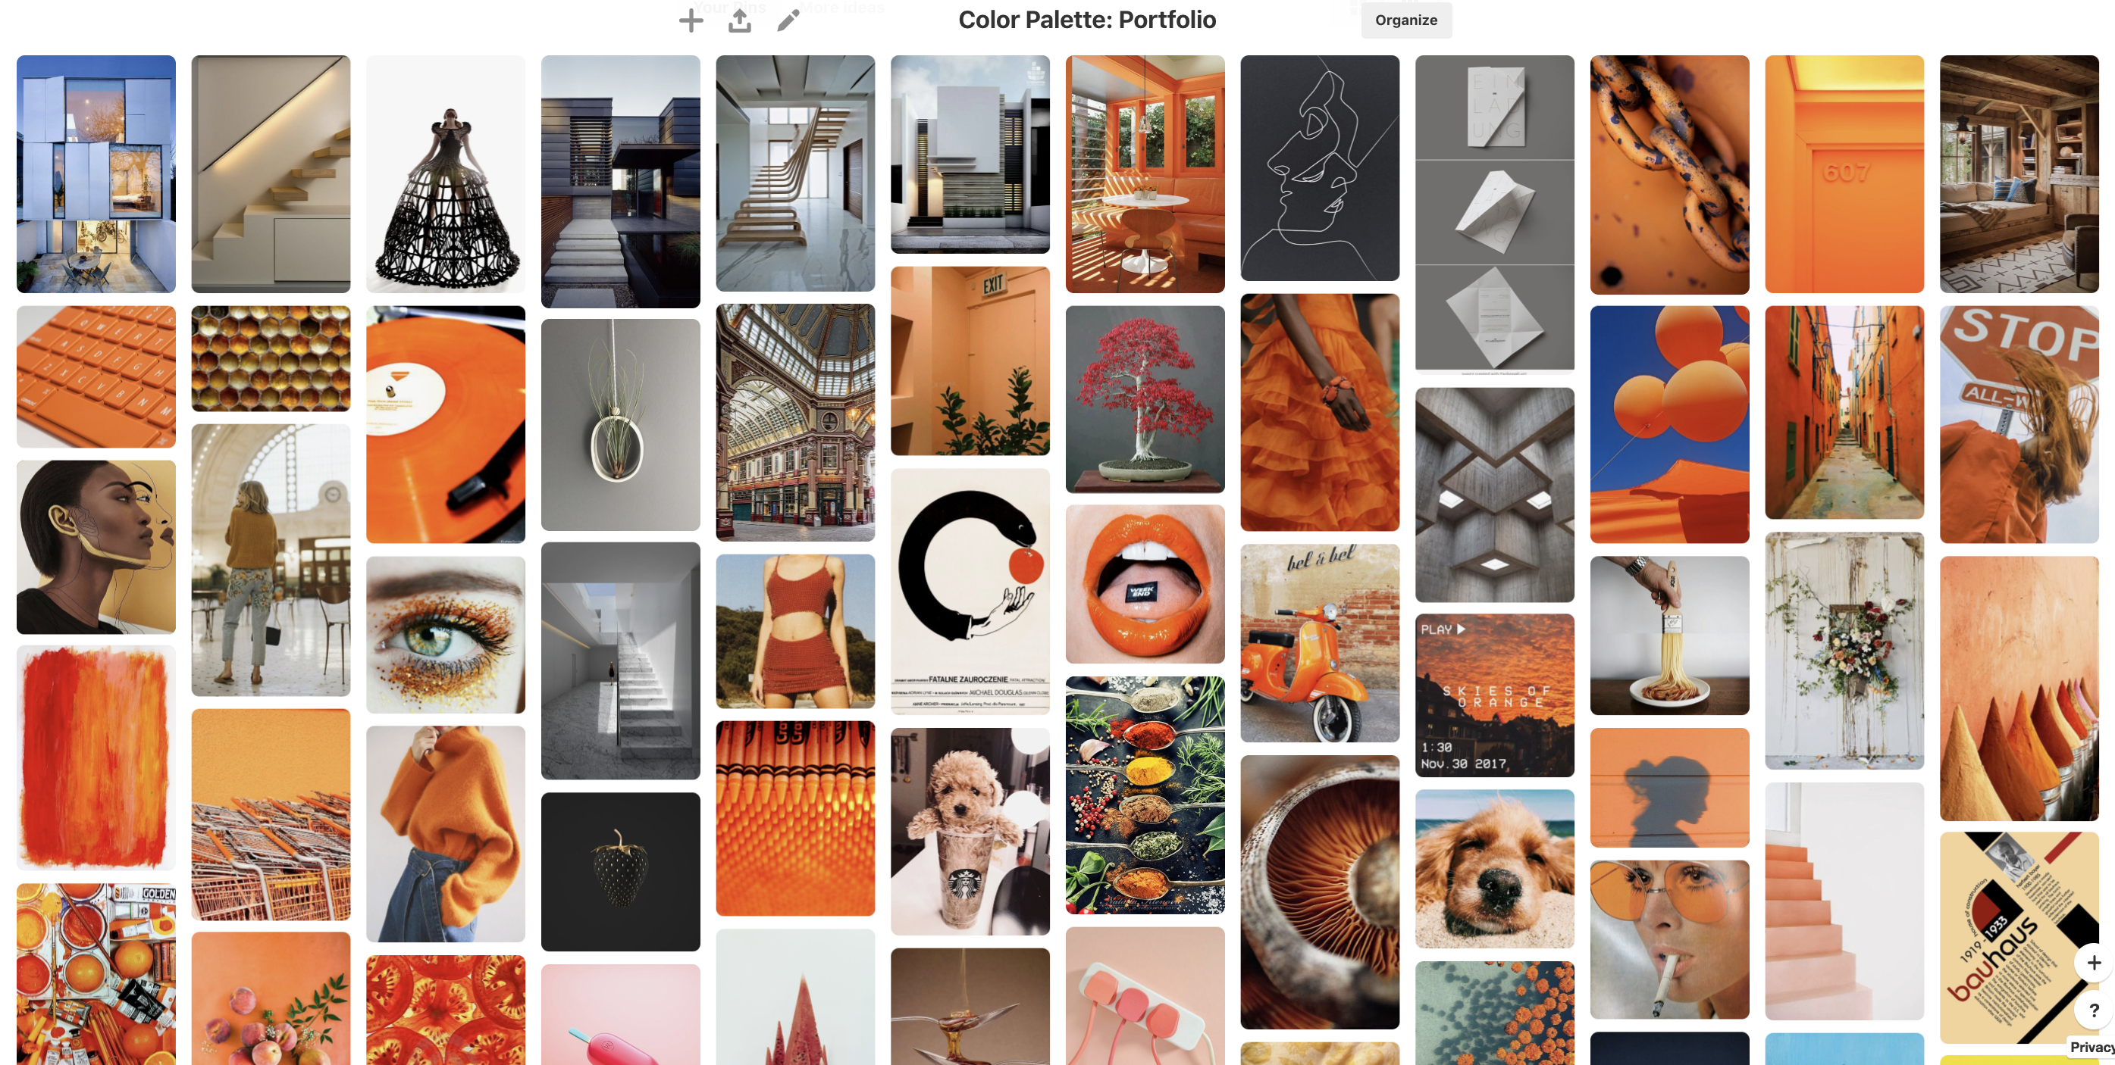
Inspirations

Slide 3
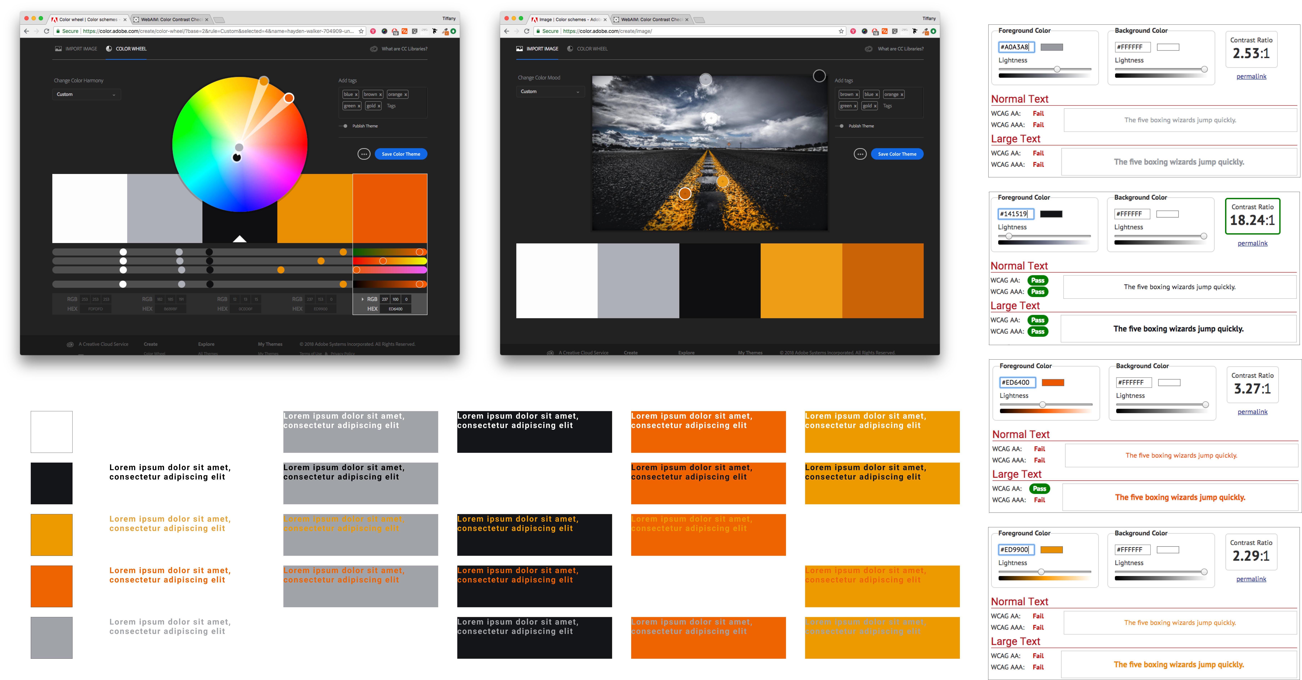
Color

Slide 4
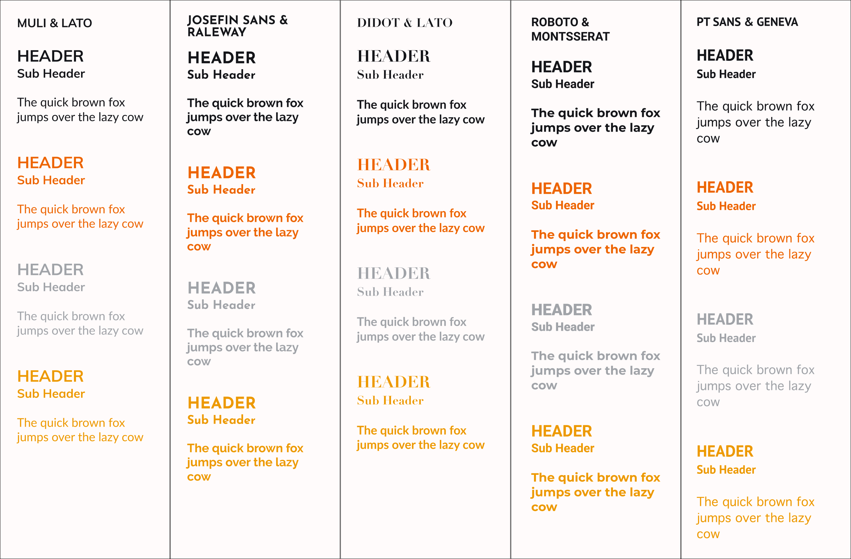
Font

Slide 5

Personal Logo

Slide 6
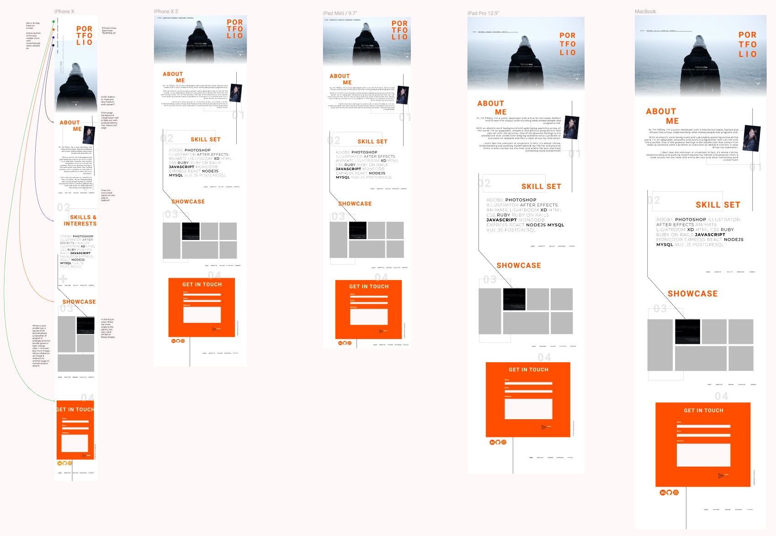
Wireframes

Slide 7
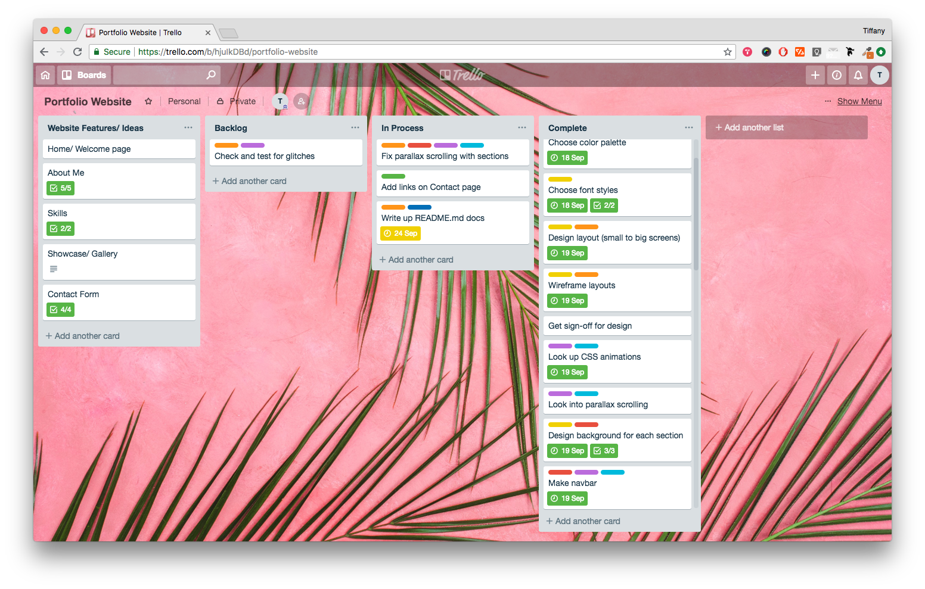
Project Management

Slide 8
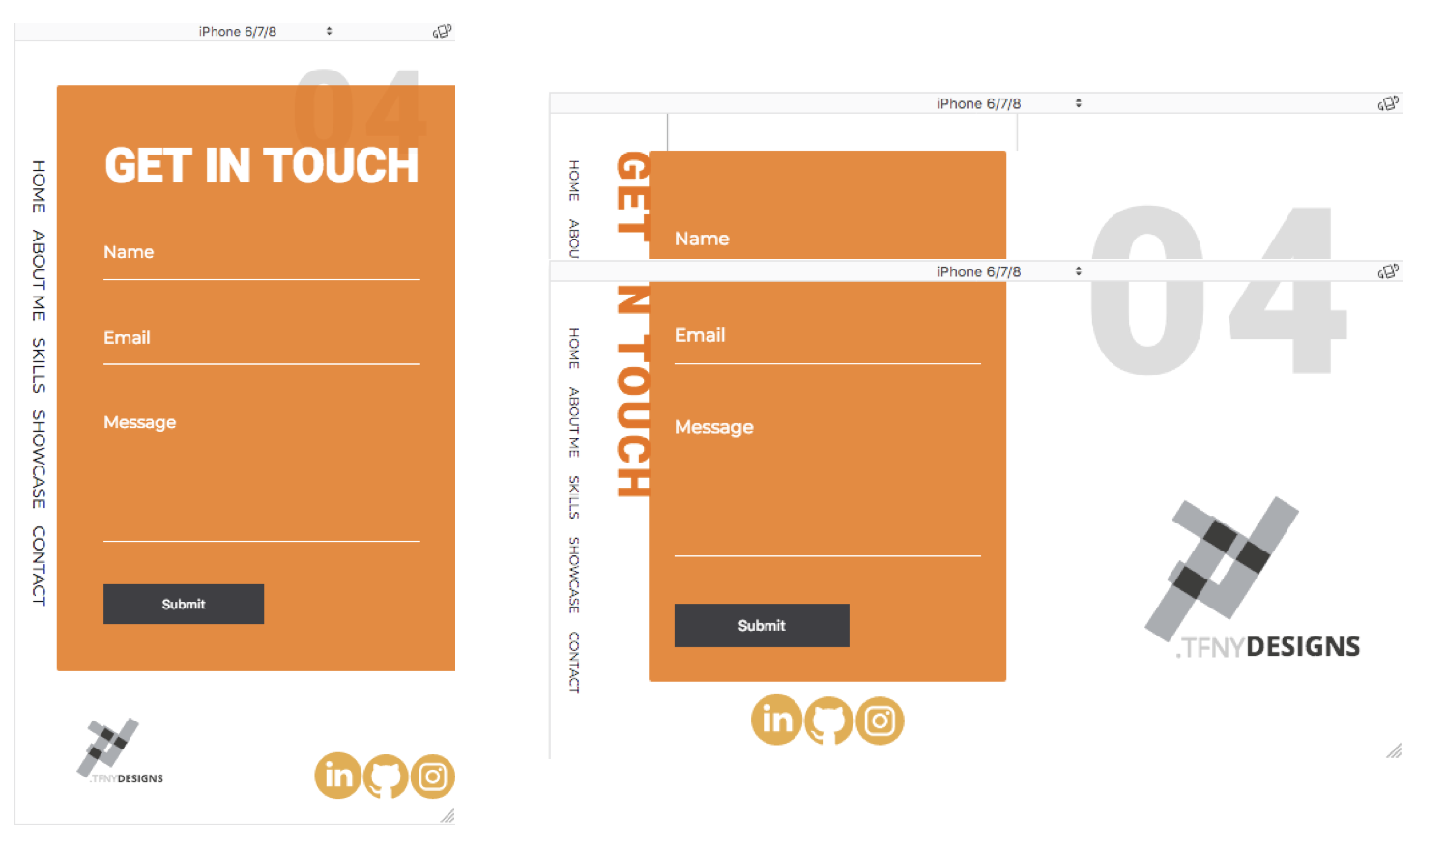
Challenges
Lack of experience
Limited to build only using HTML and CSS
Balance between design aesthetics and user experience optimization
Thoughtful creation of responsive webpage for multiple screens

Slide 9
Considerations
Alt texts were used with images
Clear navigation
Colors selected were not all WCAG AAA

Slide 10
Thank you

